Slide 1


Few Inputs and Outputs →Consistent, High-Quality Precursors to Even Higher Value End Products
Richards Ranch
Orcutt Key Site 26
March 2023
2

Slide 2
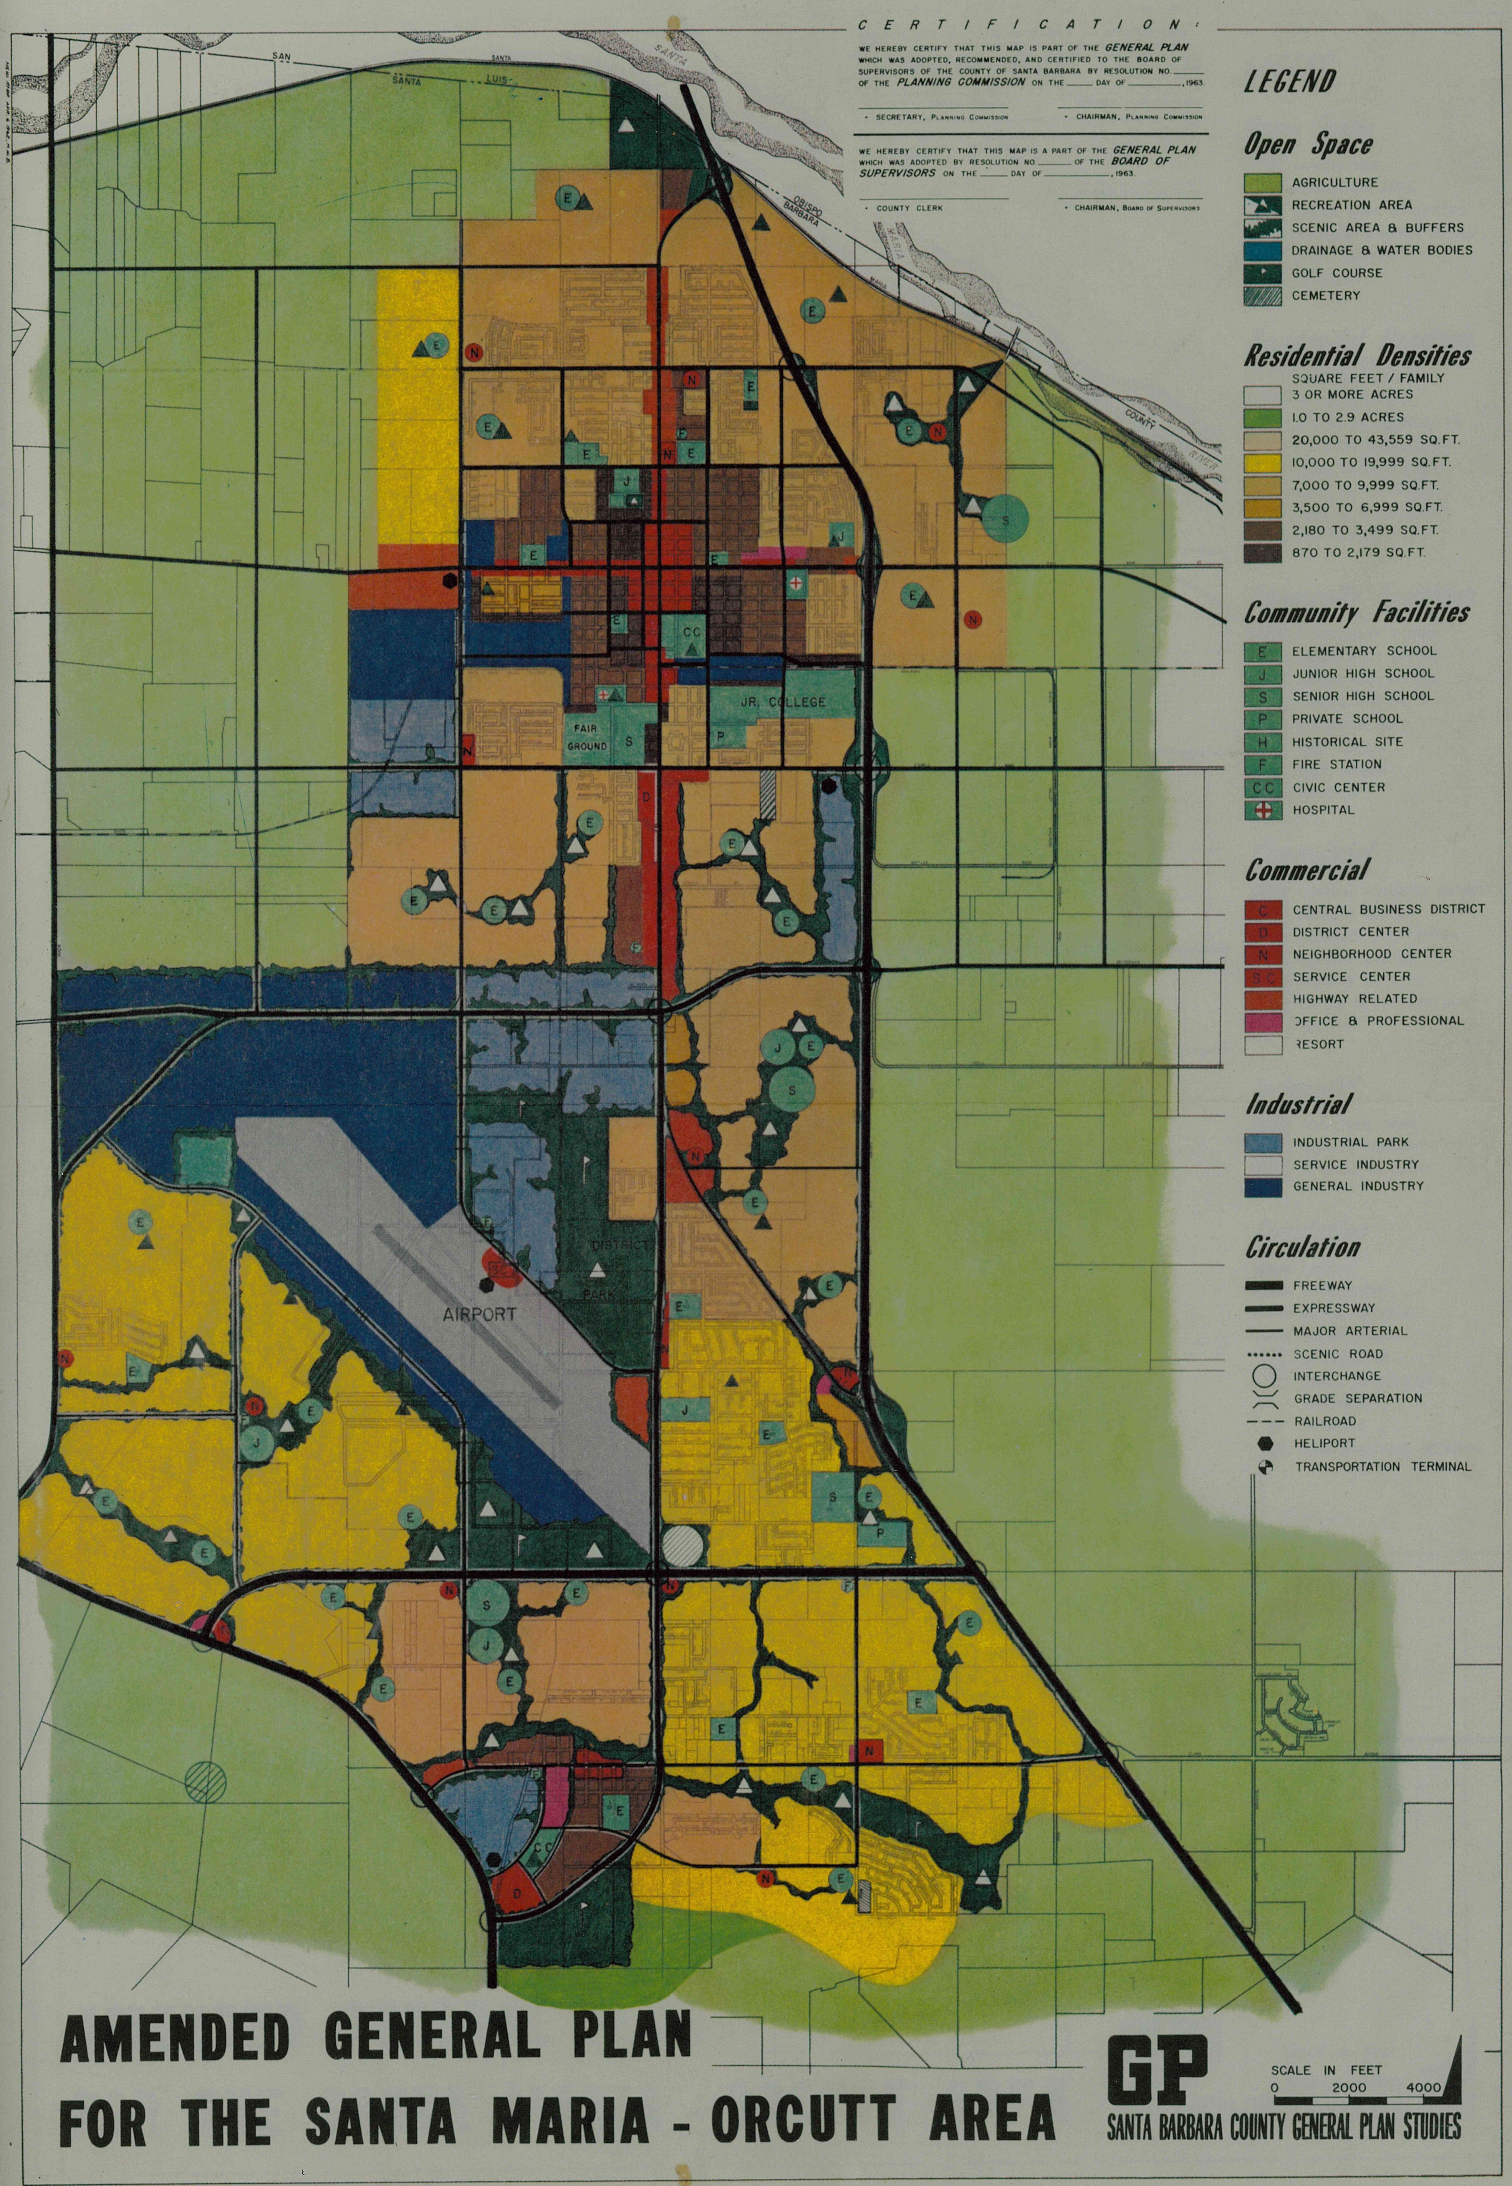

General Plan Studies Map – 1963
This general plan study identified the proposed uses on the Richards property as:
Cemetery space.
Neighborhood Commercial center.
Single Family Residential.

Slide 3
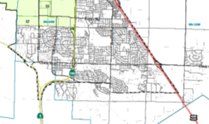
City of Santa Maria Sphere of Influence
1977. Update in 2012
The City of Santa Maria
Sphere of Influence
includes most of unincorporated Orcutt

Slide 4
Golden State Water Company
The Richards property is within the Golden State Water Company service area.

Slide 5
Laguna County Sanitation District
The Richards property is located within the Laguna County Sanitation District service area.

Slide 6
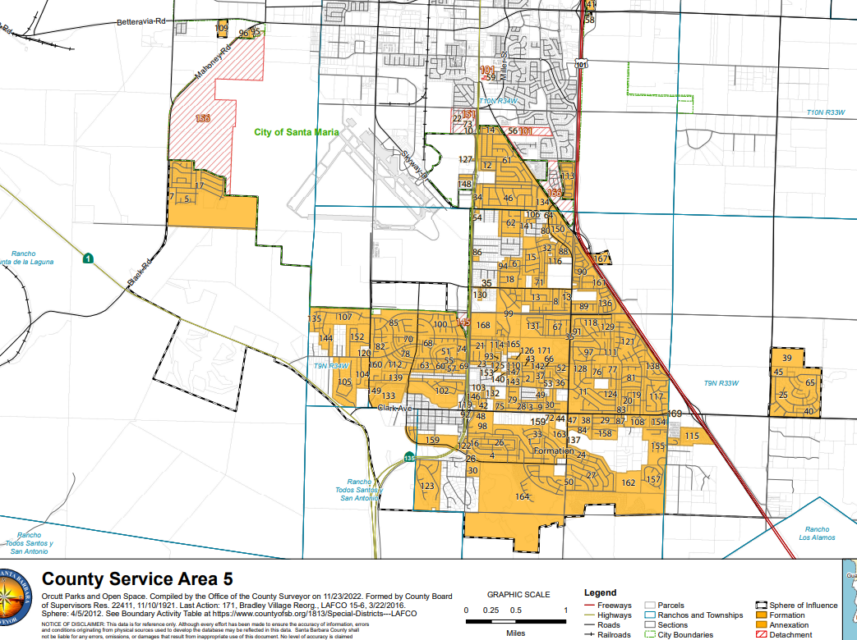

Slide 7
Richard Ranch Planning Area Annexation
 | County of Santa Barbara Orcutt Area | City of Santa Maria Annexation
Water | Golden State Water Company | Golden State Water Company
Wastewater | Laguna County Sanitation District | Laguna County Sanitation District
Service Area | CSA 5 Annexation (Lighting, Landscaping etc.) | City of Santa Maria (Lighting, Landscaping etc.)
Fire District | County Fire District (Mutual Aid Agreement) | City of Santa Maria (Mutual Aid Agreement)
Law Enforcement | County Sheriff District (Mutual Aid Agreement) | City of Santa Maria (Mutual Aid Agreement)
Roads | County Public Works | City of Santa Maria

Slide 8
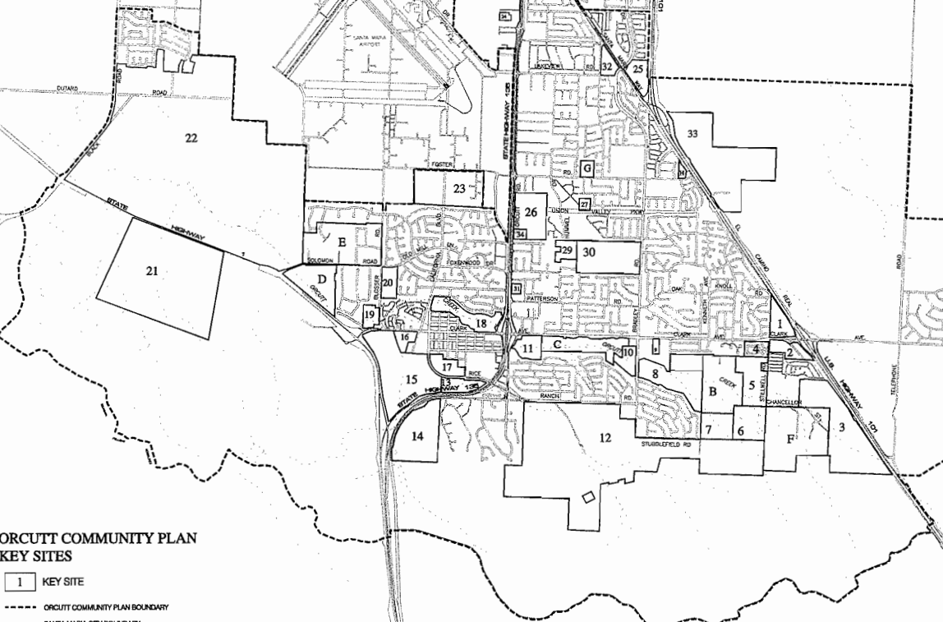
Orcutt Community Plan 1997

Slide 9
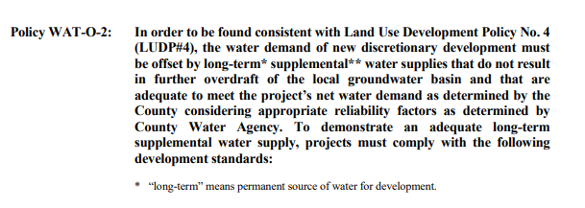

1997 Orcutt Community Plan
Water Policy WAT-O-2

Slide 10
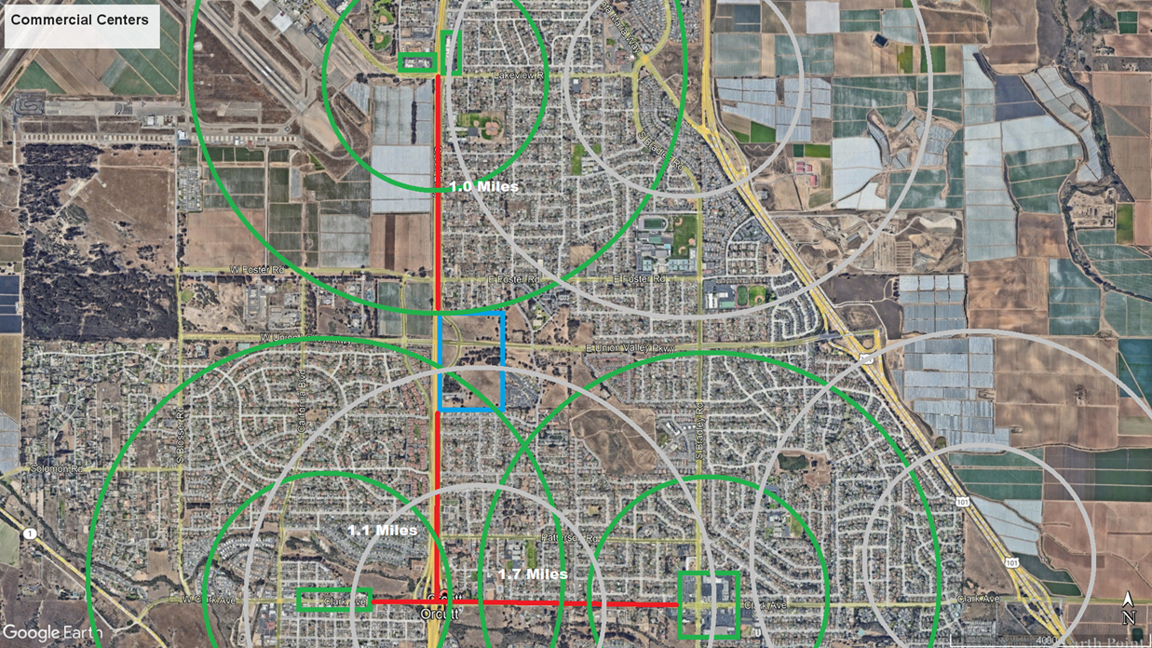
Lack of Local Commercial Sites
Distance from Richards Property to nearest commercial centers:
1.0 miles to Evergreen and Skyway Centers
1.1 miles to Old Town Orcutt
1.7 miles to Acorn and Oak Knolls Centers
Population within 2 Miles
35,000
*Most of Orcutt is services by a single Albertsons grocery store. Cost of goods in Orcutt from Gas to Groceries are higher due to lack of competition.

Slide 11
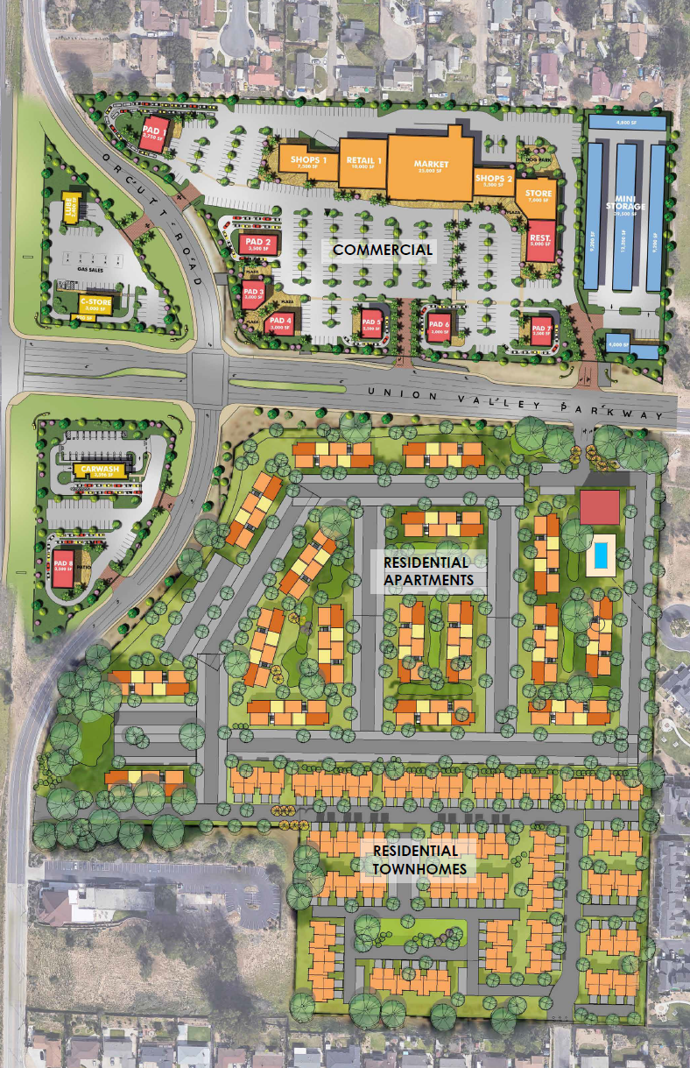
Mixed Use By Design
Neighborhood commercial, providing much needed grocer and community services.
Premium gated community apartments.
Gated townhome living.

Slide 12
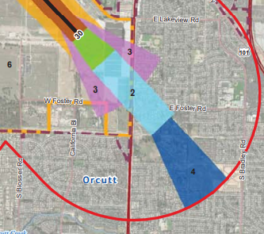
Santa Maria Airport Land Use Plan 2023
Commercial uses Safety Zone 2
allowed:
Up to 400 people/acre
Max. 70% building footprint
Residential uses allowed in Zone 4 :
Up to 25 units/acre allowed
15% of site must meet ‘open land’ criteria
All utilities must be undergrounded

Slide 13
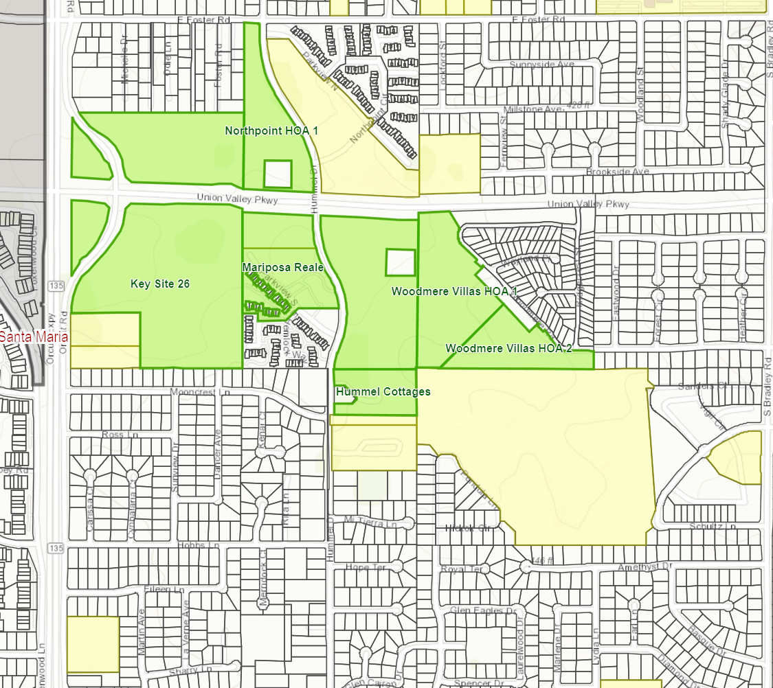
The California Housing Crises
Updated Housing Element
California is requiring the County of Santa Barbara to plan for
24,856 additional units by 2031
The county has designated
    5,664 units to be in the unincorporated areas, with
    1,522 units for North County (ie. Orcutt).
Key Site 26 proposed for 562 units and Commercial
*Green sites proposed 2022-2031 Housing Element Rezones

Slide 14
Q&A

Slide 15
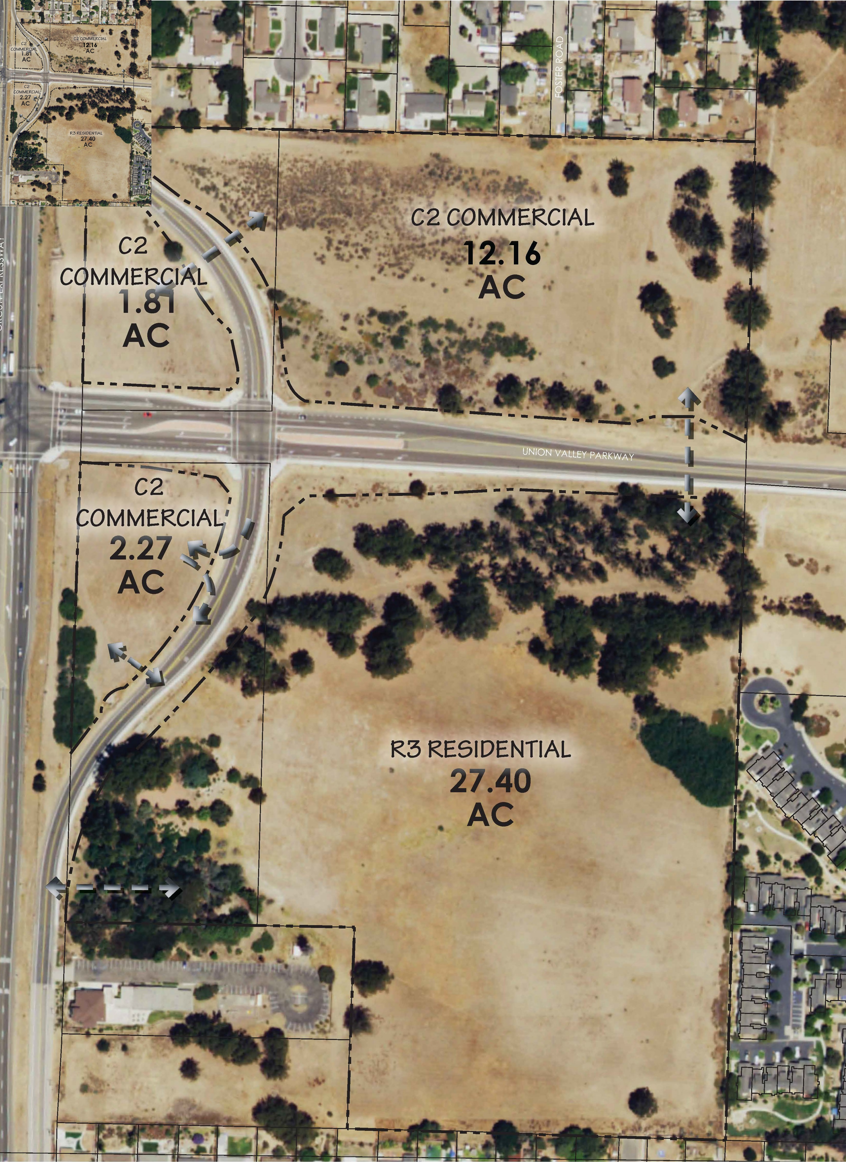
Proposed
Richards Ranch Project
Retains Retail Commercial (C-2) Zone on the north and west where residential is not conducive due to flight zones.
Currently planning a 25,000 sf neighborhood grocer with supporting neighborhood commercial services.
Residential (R-3) in the south of the property.
400 Apartments (22/Units Acre)
100 Townhomes (10/Units Acre)
*R-3 Zoning allows for 22/Units Acre throughout; however, the project proposes townhomes along the southern border.

Slide 16
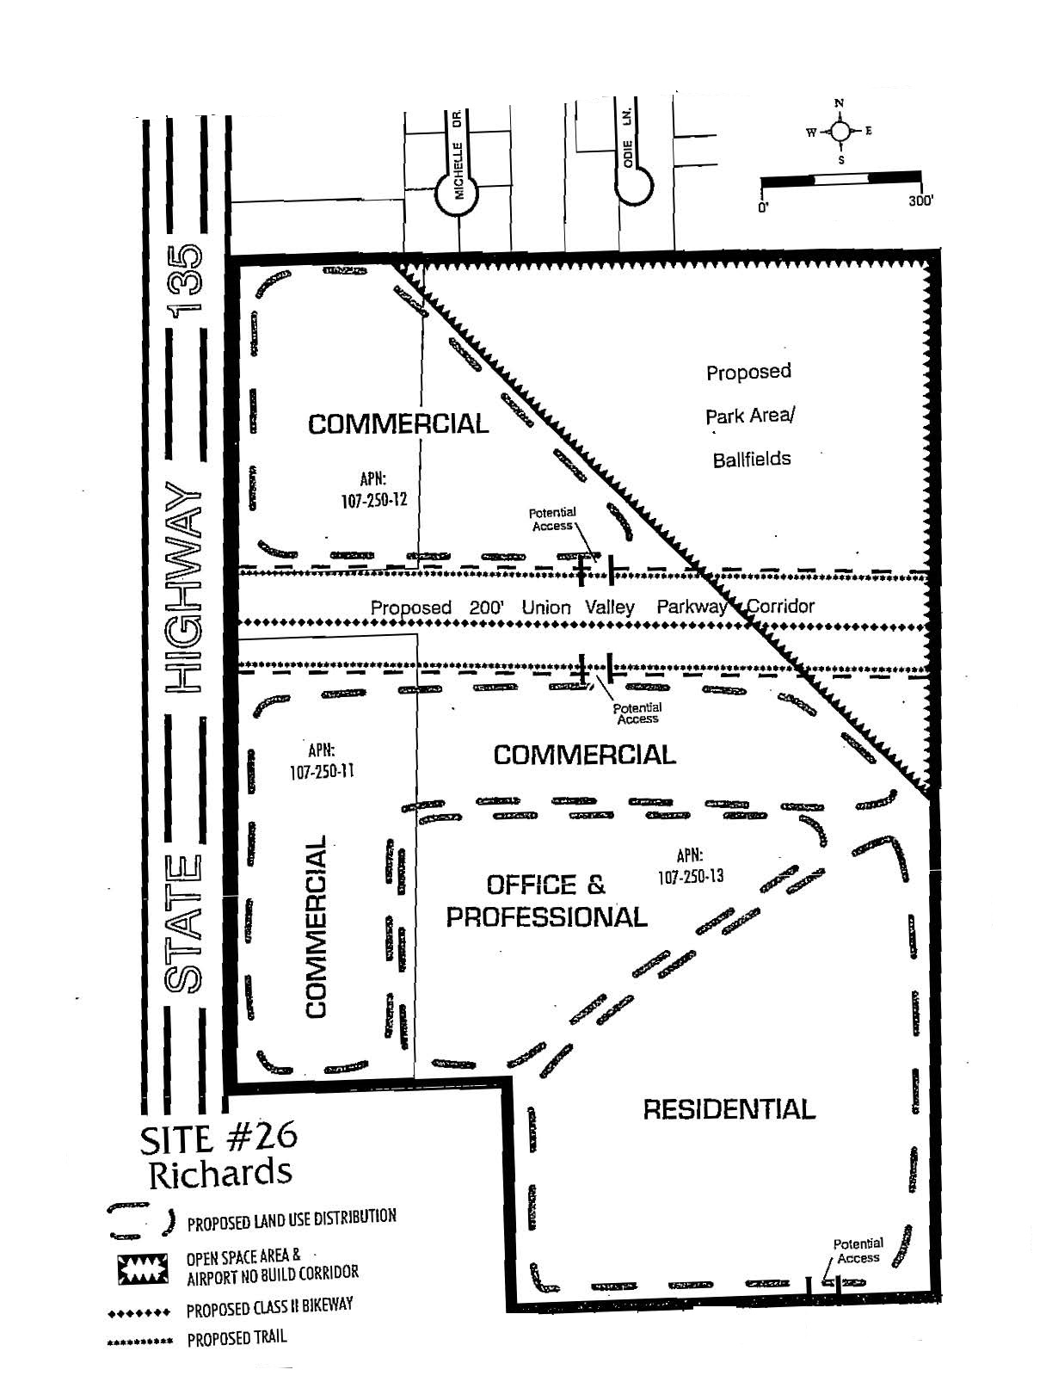
1997
Orcutt Community Plan Key Site 26
Land use designations were changed to
General Commercial,
Office and Professional
Planned Development (PD)
But the zoning was changed to all
Retail Commercial (C-2)

Slide 17
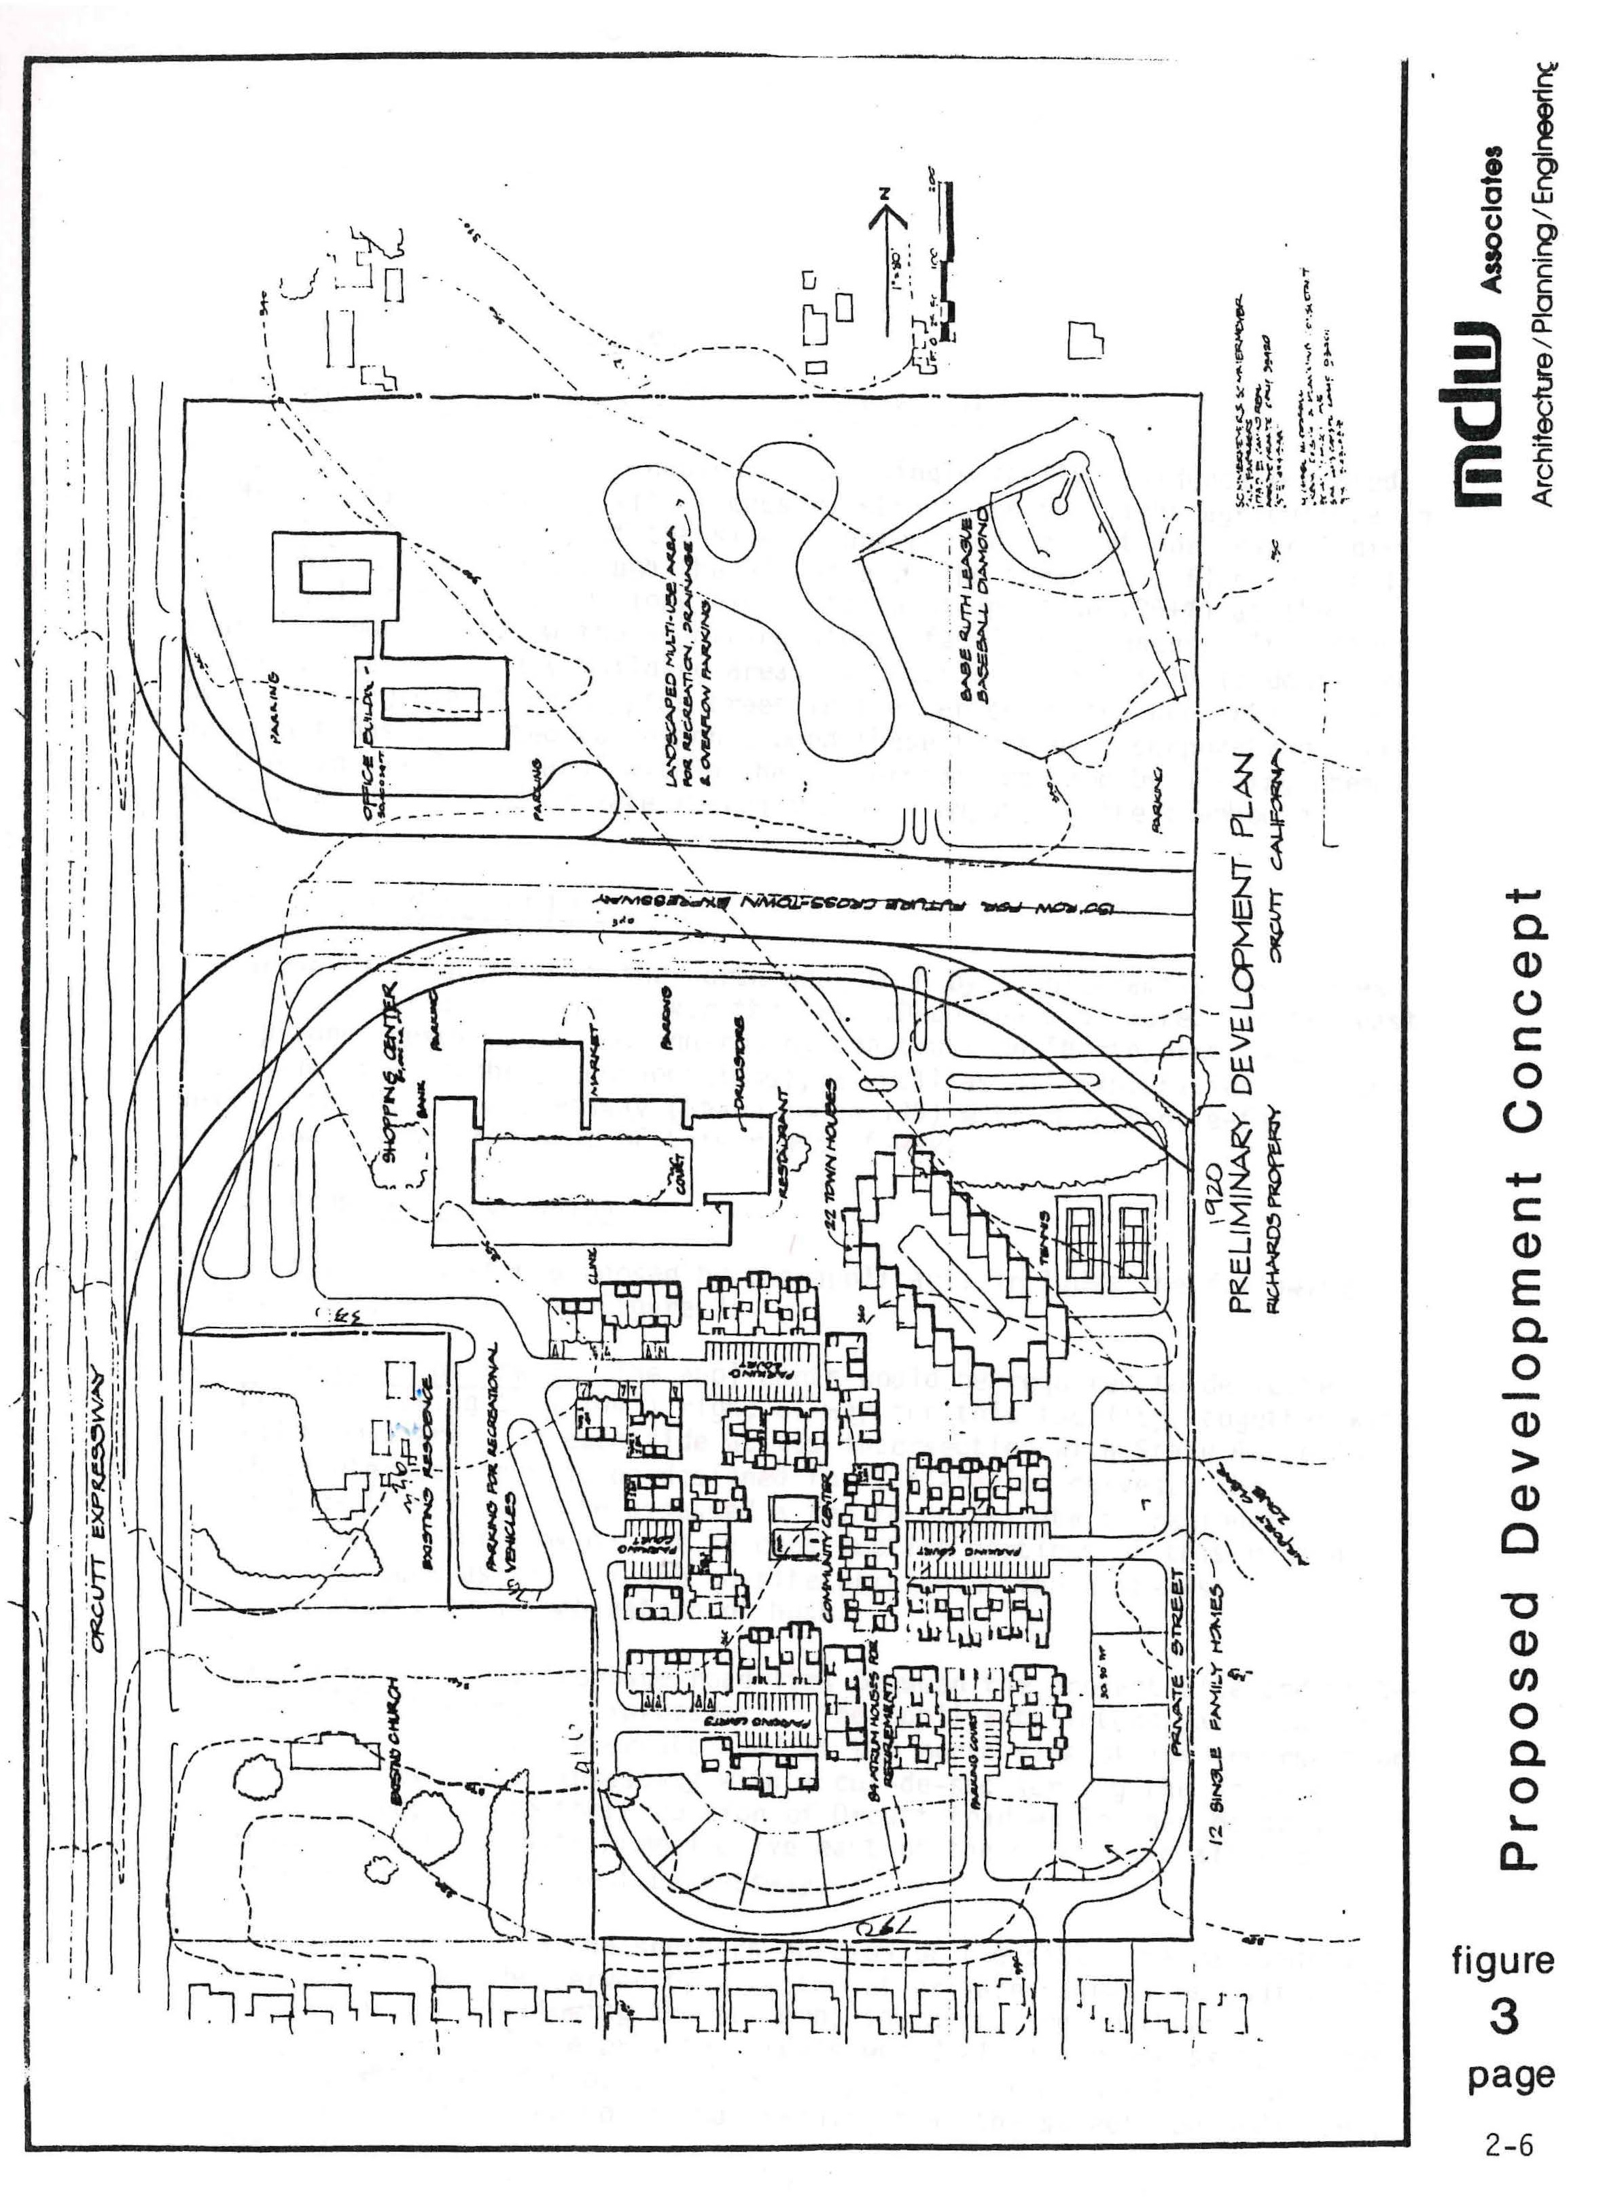
1986
Richards Specific Plan
Commercial 50,000 sf
Offices 30,000 sf
Residential uses
8-R-1 13 units
DR-4.4 22 units
DR-8.8 84 units
Rec/Open Space 10.5 acres
UVP right of way 5.9 acres

Slide 18
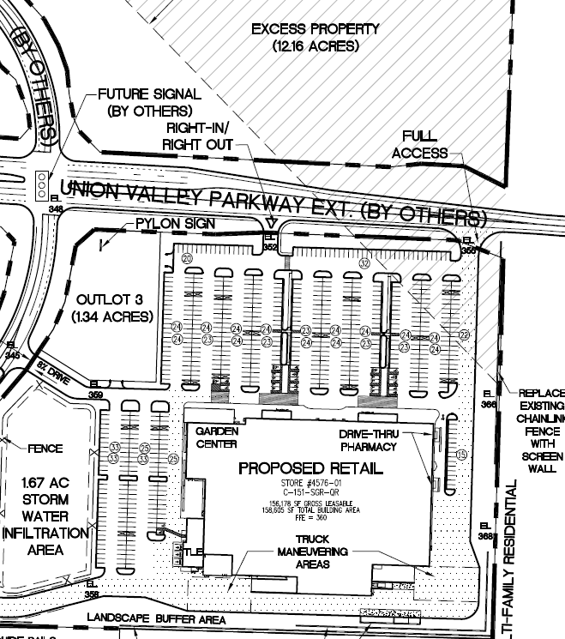
WALMART Ownership
2003 to 2021
Walmart designed a 156,000 square foot supercenter with an additional 15 acres of Commercial Property.
The City of Santa Maria would not agree to the water sale to a large commercial project in Orcutt.
Union Valley Parkway (UVP) and the UVP / HWY 135 intersection built out in 2010
Walmart sold the property in 2021
Walmart 2015 Development Drawings

Slide 19
Richards Ranch
A Neighborhood Community

Slide 20
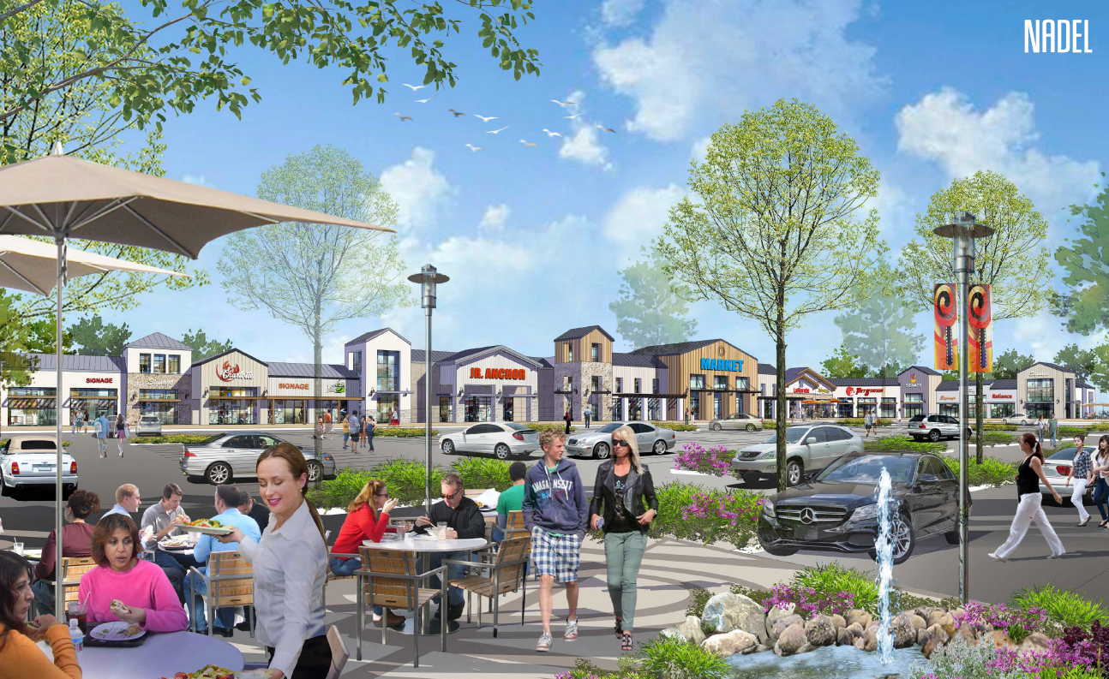
Neighborhood Commercial
Notes:
Neighborhood Specialty grocer
Local restaurants & bakery
Artisanal Coffee Shop
Bank or Credit Union
Veterinarian
Fitness Center or Gym
*Talk about the type of services you put into the creamery in SLO

Slide 21


Slide 22
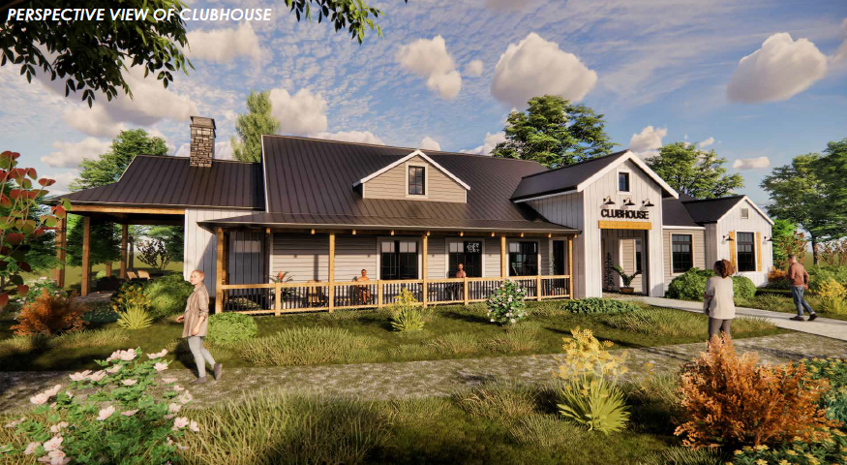
Gated Apartment Village
Notes:
Board and Batten
Metal Roofing
Cedar Siding
Stone Accents

Slide 23
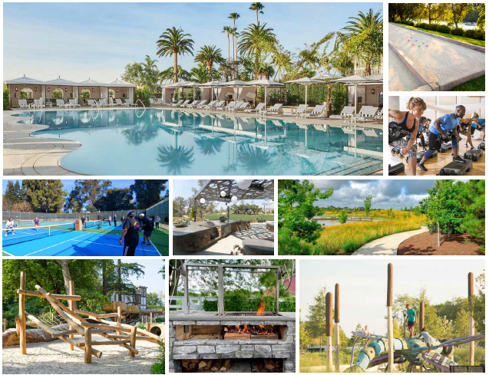
Gated Apartment Village
AMENITIES
SECURE, GATED COMMUNITY
WELCOME CONCIERGE & EVENT STAFF
TRADITIONAL & SANTA MARIA STYLE BARBECUES
COVERED OUTDOOR KITCHEN AREA
PRIVATE GARAGES
SHADED OUTDOOR AREAS WITH PICNIC TABLES
DOG PARK WITH SEATING AND PET SPA
GYM, FITNESS CENTER AND EQUIPMENT
FITNESS CLASSES SUCH AS CROSS-FIT, YOGA, SPIN
WALK-IN POOL AREA WITH CABANAS, SPA, AND
SUN DECK WITH LOUNGE CHAIRS
BAG TOSS AND GAMES AREA
PICKLEBALL COURTS
OUTDOOR FIRE PITS AND SEATING
TOT LOT, WITH NATURAL PLAY FOCUSED EQUIPMENT
RUNNING, WALKING PATH, AND FITNESS COURSE
BUSINESS CENTER WITH CO-WORKING
ENVIRONMENT, MEETING & ZOOM ROOMS
MEDITTERANEAN LANDSCAPING AND SHADE TREES
Notes:
Board and Batten
Metal Roofing
Cedar Siding
Stone Accents

Slide 24
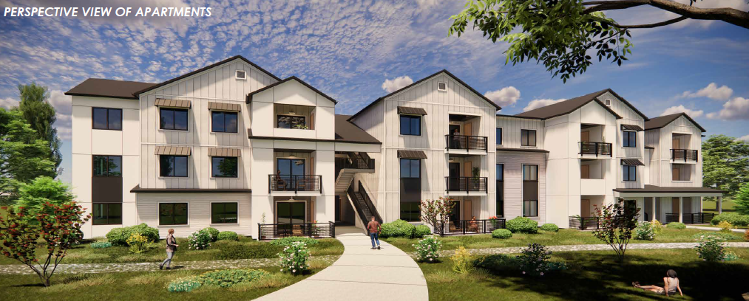
Gated Apartment Village
Notes:
Properly Parked, 2 spaces per unit with Garages
Multiple open space areas

Slide 25
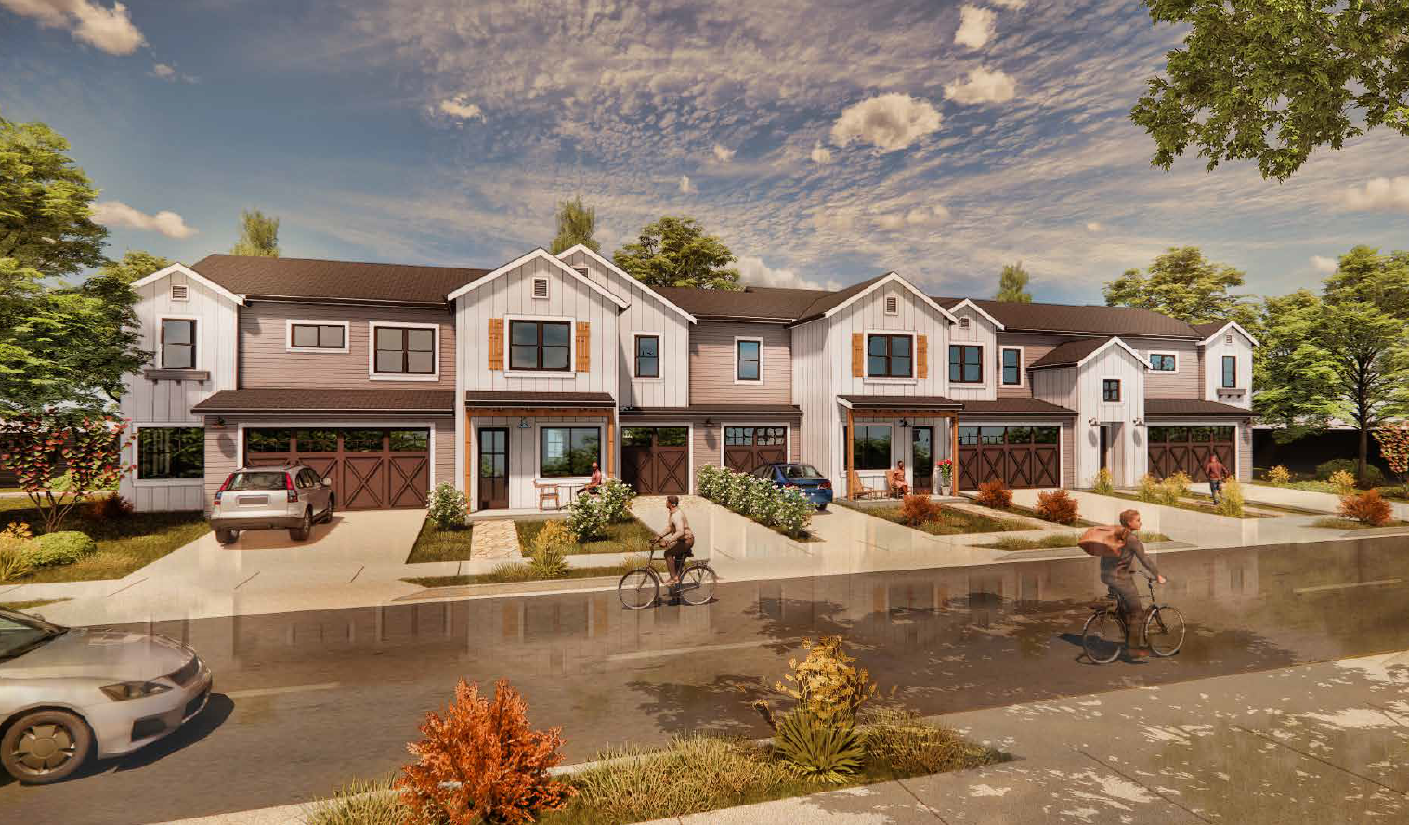
Richards Ranch Gated Townhomes
Notes:
Properly Parked, 2 spaces per unit with Garages
Multiple open space areas

Slide 26
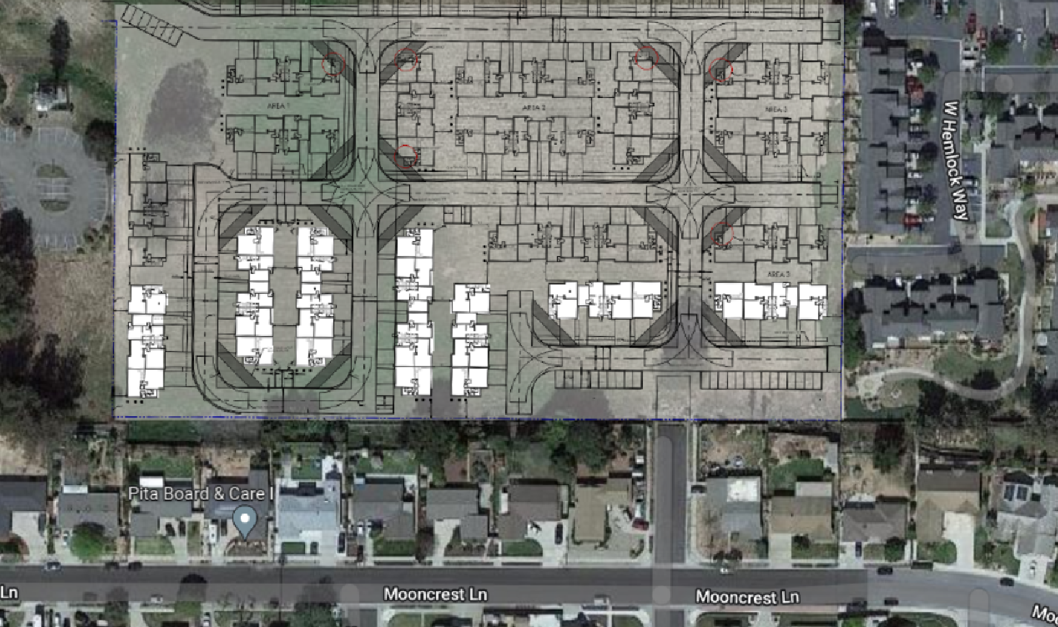
Incorporated Public Feedback
Townhomes instead of apartments
2 story instead of 3
Minimize back yard to back yard orientations with greenbelt buffer
Restrict Dancer Avenue connection

Slide 27
Area Improvements
Hummel and UVP intersection: The development will install a signal at the problematic intersection which was scheduled for installation by the county. Richards Ranch will complete UVP on all sides for its property, with four lanes.
Vehicle Miles Traveled (VMT): In California, reducing VMT is crucial for decreasing greenhouse gases (GHG) and traffic. Richards Ranch's mixed-use planning prioritizes walking, biking and bus stops and reduces the need for longer trips, thereby improving VMT.
Supplemental Water: Santa Maria will provide supplemental water allocation for the site, without affecting Orcutt residents water costs.
Airport Land Use Plan (ALUP): The site design meets all safety and zoning requirements, including Caltrans, FAA, and Airport Land Use regulations. The 2022 Airport Land Use zoning, adopted this year, predicts Santa Maria airport use currently and for the next 20 years.
Tax Exchange: The annexation will include a tax exchange agreement, directing a portion of the property's taxes to Orcutt. This will fund important services, including fire department, despite the property being in Santa Maria. Currently, the undeveloped property provides little tax support to the community.

Slide 28
Orcutt Annexations to the City of Santa Maria
Over the last 25 years,
there have been three applicant-initiated annexations to the city
Club House Estates
Foxenwood
Key Site 25

