Slide 1
Santa Barbara LAFCO
3266 Beach Club Road
Annexation to the Carpinteria Sanitary District
March 2, 2023
SANTA BARBARA LAFCO
105 East Anapamu Street  Santa Barbara CA 93101
805/568-3391  FAX 805/568-2249
www.sblafco.org  lafco@sblafco.org

Slide 2
Background
Applicant: District, by Resolution
Location: One parcel located at 3266 Beach Club Road (APNs 005-390-002) total 0.43 acres
Purpose: Annex into the Carpinteria Sanitary District to provide sanitary sewer services to an existing single-family residence
Sphere of Influence: The proposal area is outside of the District’s Sphere of Influence (Updated in 2017)
2

Slide 3
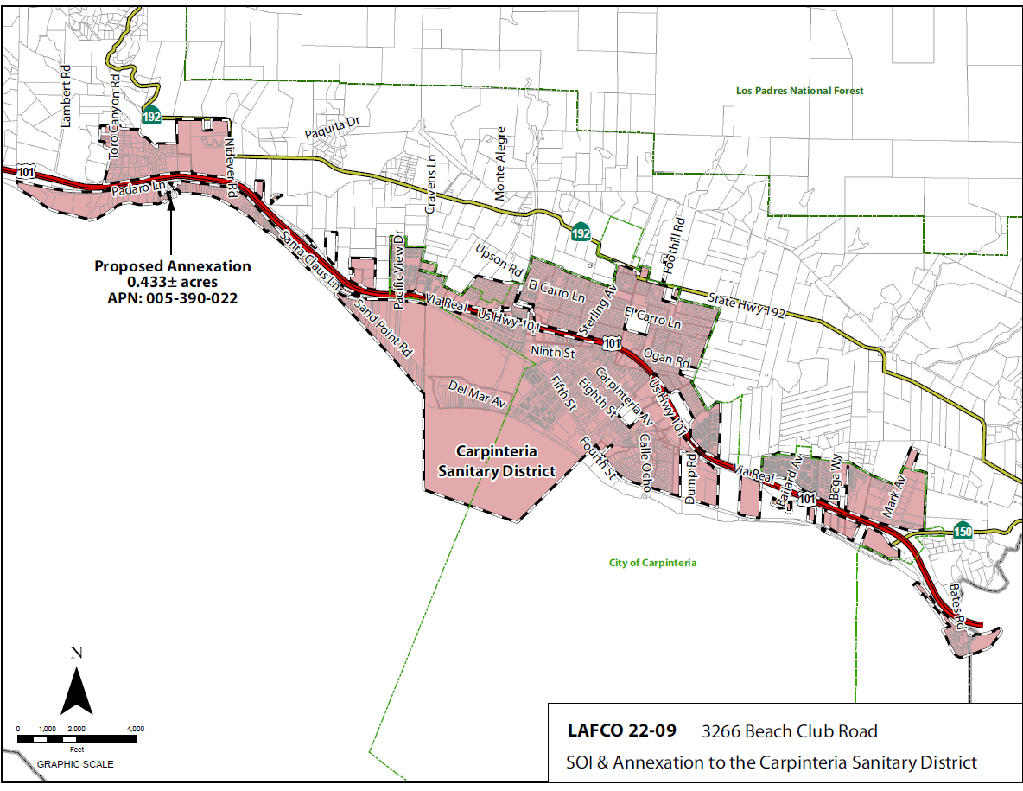
Vicinity Map
3
Notes:
3

Slide 4
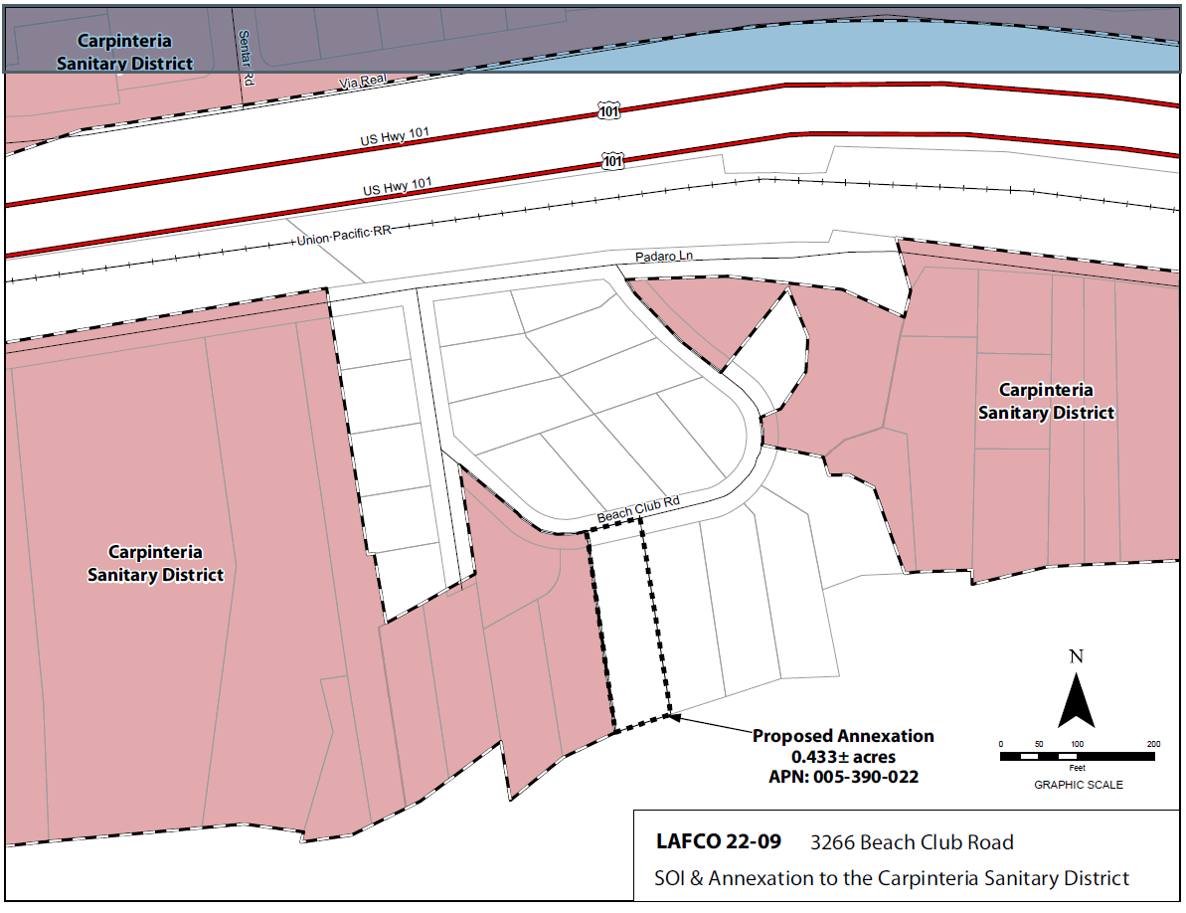
Annexation
Map
4
Notes:
4

Slide 5
Land Use, Planning and Zoning
The land use is residential with one developed parcel with one Single-Family residence
No changes in land use will be facilitated by the proposed boundary change
Land use designations and zoning are residential in the County (Residential 4.6 Zoned 8-R-1)
5

Slide 6
Plan for Services
The District’s Plan for Services outline the adequate services, facilities, and improvements
The Plan for Services address the provision of governmental services and financing of improvements
Plan for Services found in Attachment F
Existing sewer line is northerly on Padaro Lane at approx. 200 lineal feet
6

Slide 7
Environmental Determination
The proposal is Categorically Exemption pursuant to Public Resources Code Sections 21000, Section 15319, Class 19 & Section 15303, Class 3
Annexation of individual small parcels for facilities exempt by Section 15303 & Section 15303, Class 3 New Construction or Conversion of Small Structures
7

Slide 8
District and Landowner Consent
Parcel is “uninhabited” – less than 12 voters (GC sec. 56079.5)
The District has consented to waving conducting authority proceedings
The Property owners have also consented to the annexation
Therefore, the annexation can proceed without notice, hearing and election
8

Slide 9
Conclusion
The site is located in an area that allows the District to best provide services in the future
The proposed sphere of influence amendment and annexation represents a reasonable and logical extension of district services
9

Slide 10
Recommendation
OPTION 1 – APPROVE the proposal and resolution as follows:
Find the proposal to be exempt from the California Environmental Quality Act (CEQA) pursuant to CEQA Guidelines section 15303, Class 3 New Construction or Conversion of Small Structures and 15319, Class 19 Annexations of Existing Facilities and Lots for facilities Exempt Facilities .
Amend the Spheres of Influence of the annexing agency to include the property;
Approve the proposal, to be known as 3266 Beach Club Road SOI and Annexation to the Carpinteria Sanitary District;
Condition approval upon the annexed territory being liable for any existing indebtedness and authorized taxes, charges, fees and assessments of the Carpinteria Sanitary District;
Find the subject territory is uninhabited; all affected landowners have given written consent and the annexing agency has given written consent to the waiver of conducting authority proceedings; and.
Waive the conducting authority proceedings and direct the staff to complete the proceeding.
10

