Slide 1
Santa Barbara LAFCO
399 S. Arboleda Rd.
Annexation to the Goleta Sanitary District
March 2, 2023
SANTA BARBARA LAFCO
105 East Anapamu Street  Santa Barbara CA 93101
805/568-3391  FAX 805/568-2249
www.sblafco.org  lafco@sblafco.org

Slide 2
Background
Applicant: Landowner, by petition
Location: parcel is located at 399 S. Arboleda Rd. (APN 061-210-004) 1.6 acres
Purpose: Annex into the Goleta Sanitary District to provide sanitary sewer services to an existing single-family residence and small guest cottage
Sphere of Influence: The proposal area is within the District’s Sphere of Influence (Updated in 2016)
2

Slide 3
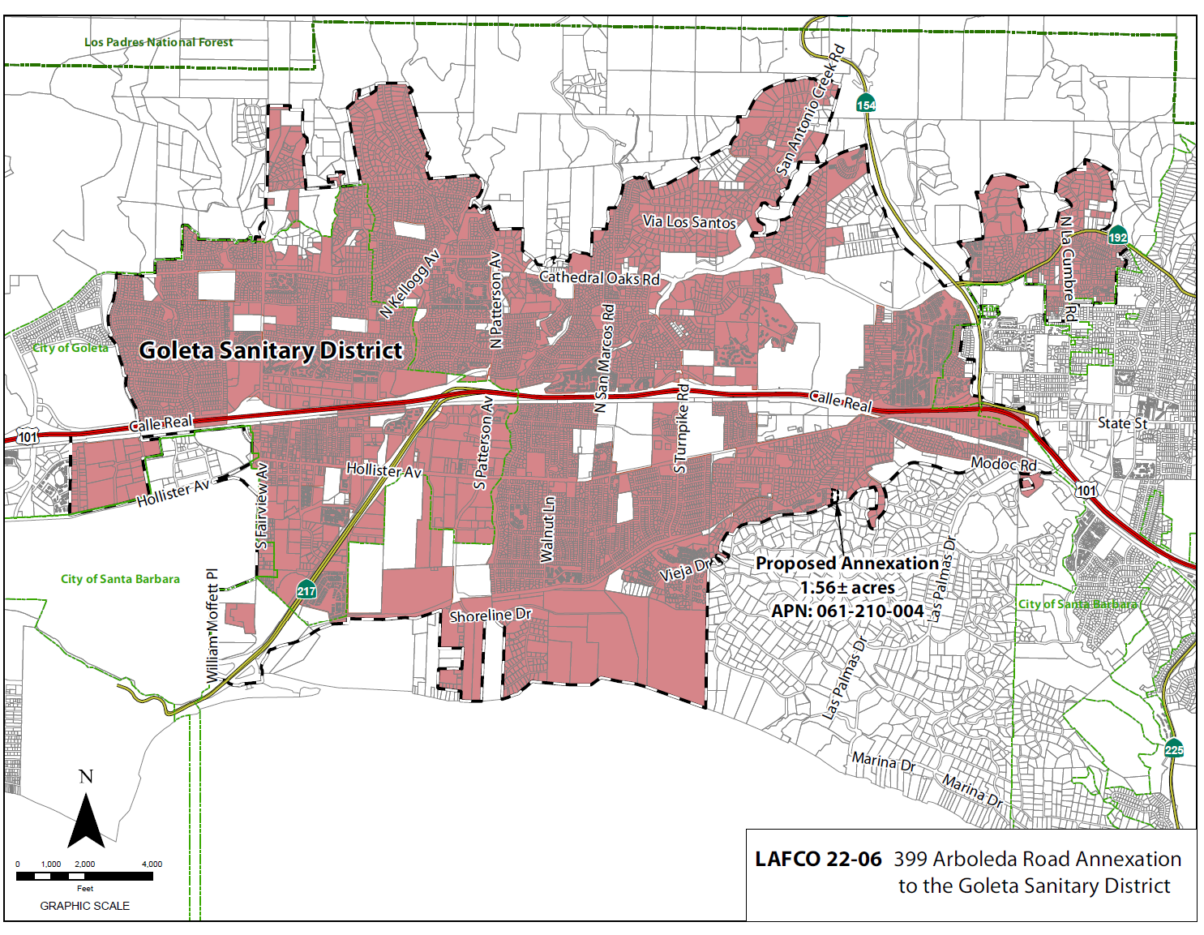
Vicinity Map
3
Notes:
3

Slide 4
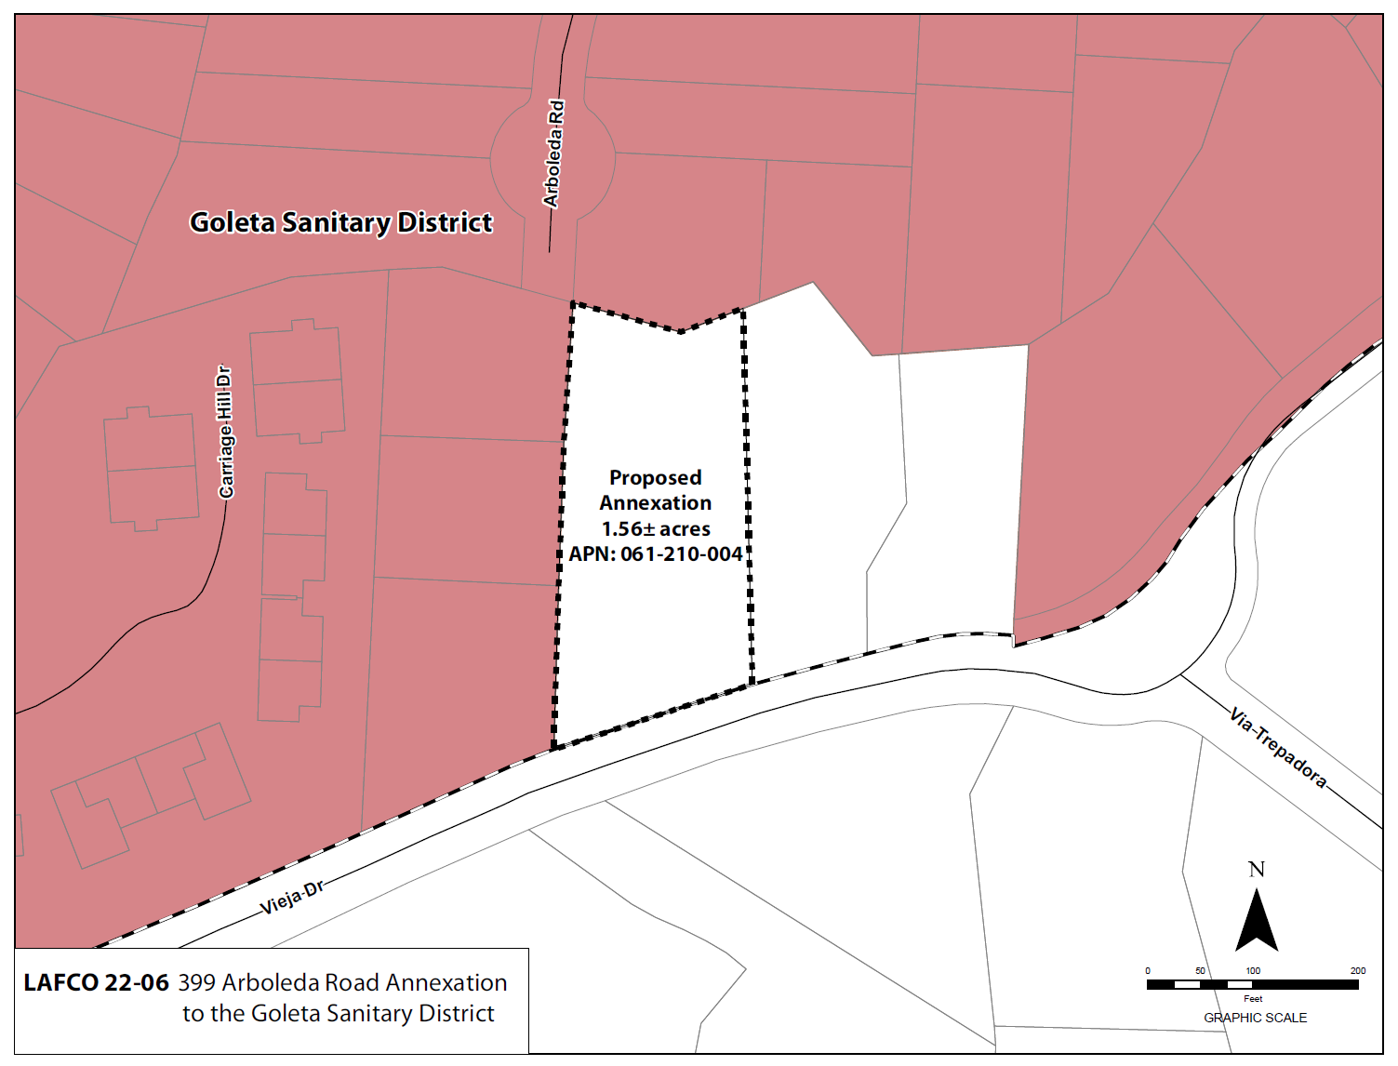
Annexation
Map
4
Notes:
4

Slide 5
Land Use, Planning and Zoning
The land use is residential with one developed Single-Family residence and a smaller guest cottage located south of the main home
No changes in land use will be facilitated by the proposed boundary change
Land use designations and zoning are residential in the County (Residential 1.8 zoned 20-R-1)
5

Slide 6
Plan for Services
The District’s Plan for Services outline the adequate services, facilities, and improvements
The Plan for Services address the provision of governmental services and financing of improvements
Plan for Services found in Attachment E
Existing sewer line is located one parcel away to the west (398 Arboleda Rd.). The neighbor is agreeable to the proposal, and a private easement will be produced.
6

Slide 7
Environmental Determination
The proposal is Categorically Exemption pursuant to Public Resources Code Sections 21000, Section 15301 Class 1, section 15303, Class 3, and section 15319, Class 19
Alteration of existing public or private structures, facilities, New Construction or Conversion of Small Structures, and Annexation of existing facilities and lots for exempt facilities
7

Slide 8
District and Landowner Consent
Parcel is “uninhabited” – less than 12 voters (GC sec. 56079.5)
The District has consented to waving conducting authority proceedings
The Property owners have also consented to the annexation
Therefore, the annexation can proceed without notice, hearing and election
8

Slide 9
Conclusion
The site is located in an area that allows the District to best provide services in the future
The proposed annexation represents a reasonable and logical extension of district services
9

Slide 10
Recommendation
OPTION 1 – APPROVE the proposal and resolution as follows:
Find the proposal to be exempt from the California Environmental Quality Act (CEQA) pursuant to CEQA Guidelines section 15301 Class 1 alteration of existing public or private structures, facilities, etc., involving negligible or no expansion of existing or former use; Section 15303 Class 3 New Construction or Conversion of Small Structures; and Section 15319(b), Class 19 Annexations of individual small parcels for facilities exempted by Section 15303.
Condition approval upon the annexed territory being liable for any existing indebtedness and authorized taxes, charges, fees and assessments of the Goleta Sanitary District;
Find the subject territory is uninhabited; all affected landowners have given written consent and the annexing agency has given written consent to the waiver of conducting authority proceedings; and.
Waive the conducting authority proceedings and direct the staff to complete the proceeding.
10

